Slide 1
DEPARTMENT OF EDUCATION
ALS CONVERGENCE LEARNING PROJECT
PROJECT BRIEF

Slide 2
CONTENTS
KEY TOPICS
About the ALS Convergence Project
Project Objectives
Project Strategies
Implementation
Timeline
SANDIWAAN CENTER FOR LEARNING | 2020

Slide 3
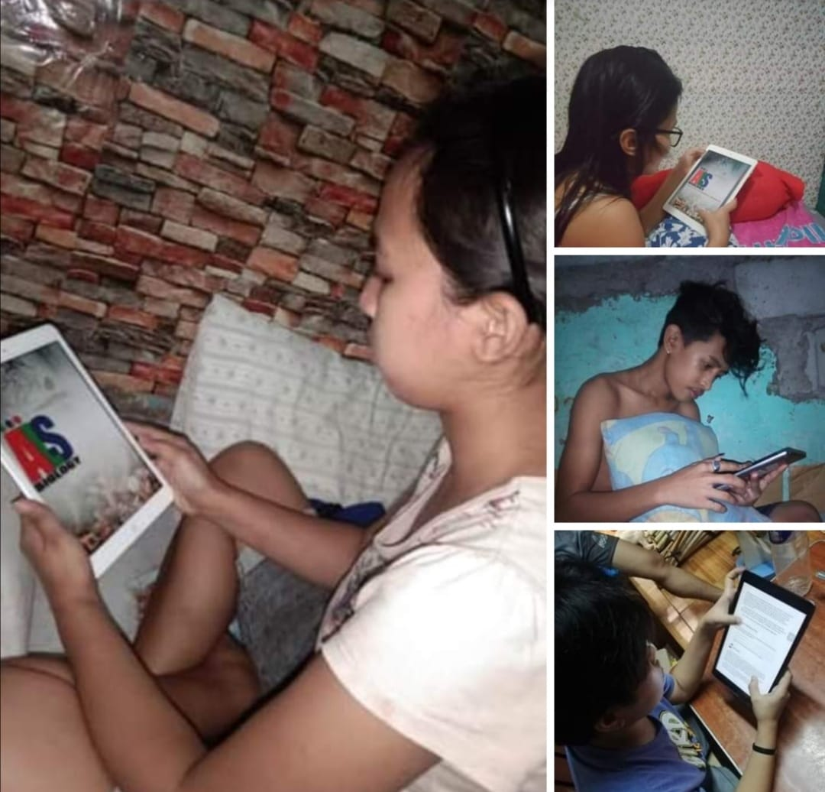
ABOUT THE ALS CONVERGENCE PROJECT
GOAL
To build a blended virtual learning environment for 15,000 out-of-school youth in the 16 divisions of the Department of Education Alternative Learning Systems (ALS) NCR.
SANDIWAAN CENTER FOR LEARNING | 2020

Slide 4
CONVERGENCE THEORY OF LEARNING
CORE TENET
The CTL believes that schools should teach students how to become better human beings. They should be guided by values that can help assure that the evolution of the human race will continue. Therefore, the fundamental educational objective of the CTL is the inculcation of the values of Integrity, Solidarity and Creativity.
SANDIWAAN CENTER FOR LEARNING | 2020

Slide 5
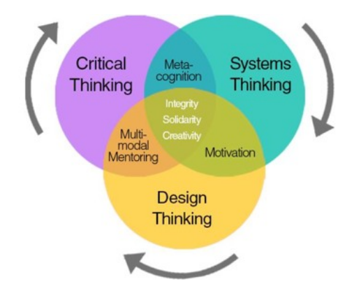
DEVELOPING 3 WAYS OF THINKING:
CRITICAL
SYSTEMS
DESIGN
USING 3 GENERAL APPROACHES:
MOTIVATION
META-COGNITION
MULTI-MODAL MENTORING
SANDIWAAN CENTER FOR LEARNING | 2020

Slide 6
CONVERGENCE
GOVERNMENT
ACADEME
INDUSTRY
DEPED ALS
DEPED NCR
NCR LGUS
SANDIWAAN CENTER FOR LEARNING
STATE UNIVERSITY OF NEW YORK
NATIONAL TEACHERS COLLEGE
NATIONAL DIGITAL EDUCATORS SOCIETY
PHILIPPINE NORMAL UNIVERSITY
SOLAR ENTERTAINMENT
CYPHER LEARNING
SANDIWAAN CENTER FOR LEARNING | 2020

Slide 7
Objectives
CURRICULUM
ALS LEARNERS
Digitizing the ALS Curriculum and infusing it with elements from the Convergence Theory of Learning
ALS Learners will learn and gain knowledge, skills, and attitudes through various approaches in a blended learning program designed to be adaptive and personalized for each learner.
ALS TEACHERS
STRUCTURE
DepEd-NCR’s ALS Teachers must be upskilled on Instructional Design, Integrating ICT in Instruction, and the Convergence Theory of Learning
Develop a virtual learning environment that aggregates all teaching and learning activities for Deped ALS using a multimodal approach.
SANDIWAAN CENTER FOR LEARNING | 2020

Slide 8
STRATEGIES: CURRICULUM
DIGITIZE
Digitize the ALS Curriculum and facilitate the curation and creation of appropriate learning resources aligned to the learning strands.
DEVELOP
Develop a set of digital learning guidelines and fair use policies specific to the project.
DESIGN
Design a digital learning format that reflects the multimodal nature of ALS
SANDIWAAN CENTER FOR LEARNING | 2020

Slide 9
STRATEGIES: ALS TEACHERS
PROFESSIONAL DEVELOPMENT
COMMUNITY BUILDING
MENTORING
Provide mentors who are SMEs in ICT, Pedagogy, and content area
Train all 200 NCR ALS teachers on the use of digital tools, instructional design, and CTL
Cultivate a community of practice (COP) among ALS Teachers
SANDIWAAN CENTER FOR LEARNING | 2020

Slide 10
STRATEGIES: ALS LEARNERS
Track progress and learning activities
Create a group of volunteer mentors to help motivate learners
Provide reviews and test preparation classes to improve NCR ALS Equivalency passing rate
Digitize RPL, ILA, FLT, and personal portfolio
Provide orientation and assistance in getting started
SANDIWAAN CENTER FOR LEARNING | 2020

Slide 11
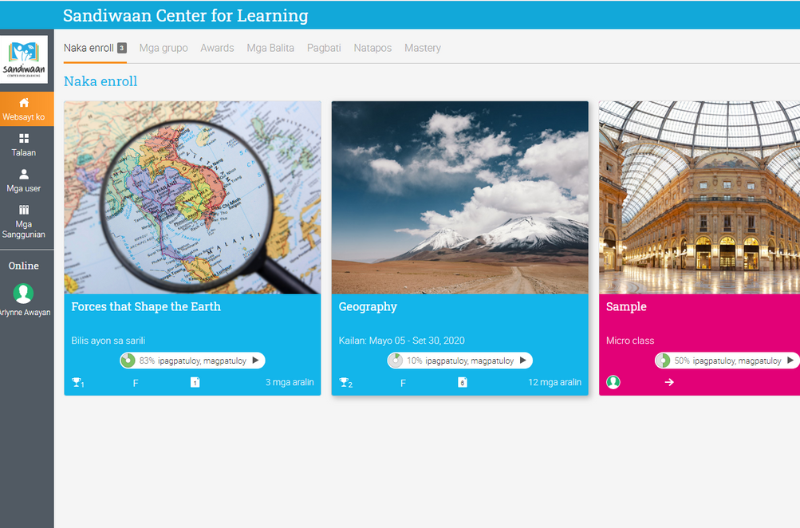
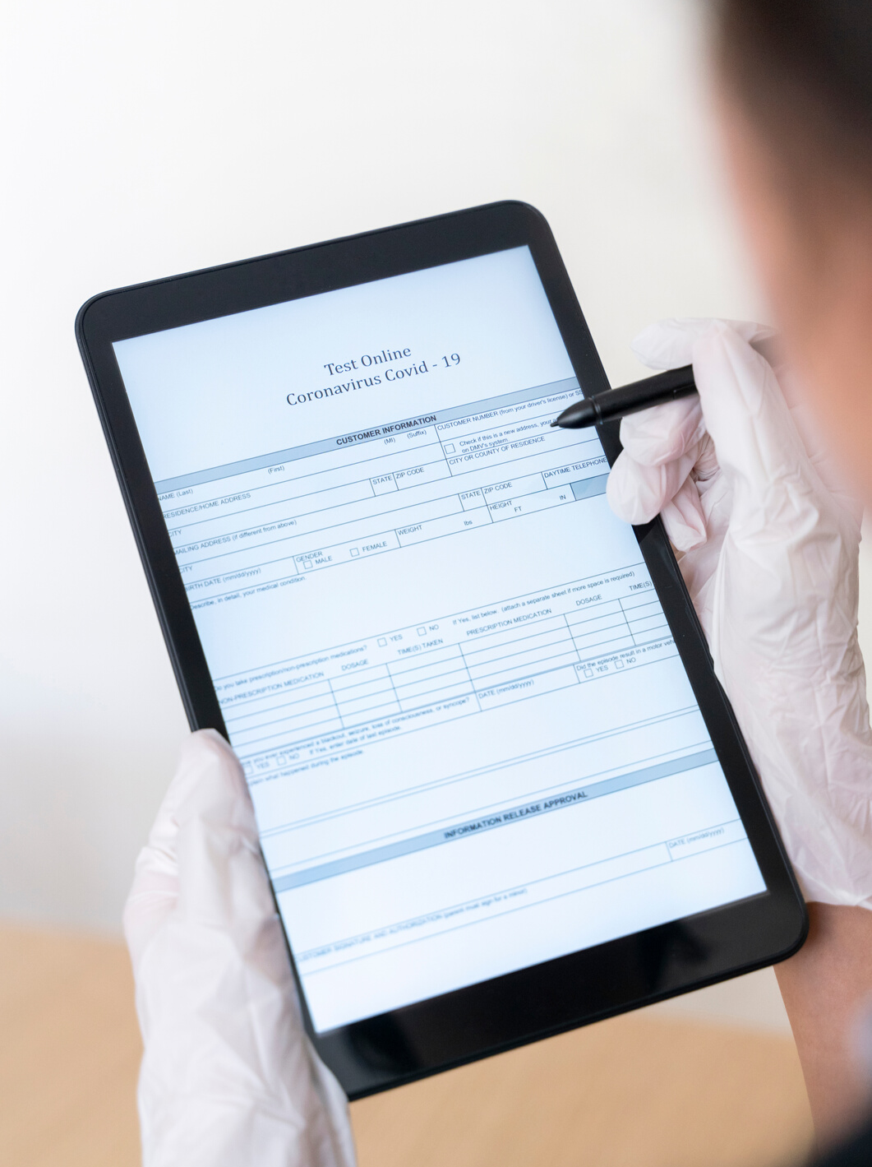
STRATEGIES: STRUCTURE
VIRTUAL LEARNING ENVIRONMENT
Use a learning management system to track all learning activities both online and offline.
MULTI-MODAL ACCESS TO LEARNING CONTENT
Make learning available via digital (internet), broadcast (digital TV), or offline using mobile devices
MULTI-MODAL ASSESSMENT
Learners can take online tests, submit evidence of student work online or via designated ALS Learner workstations within the baranggays.
SANDIWAAN CENTER FOR LEARNING | 2020

Slide 12
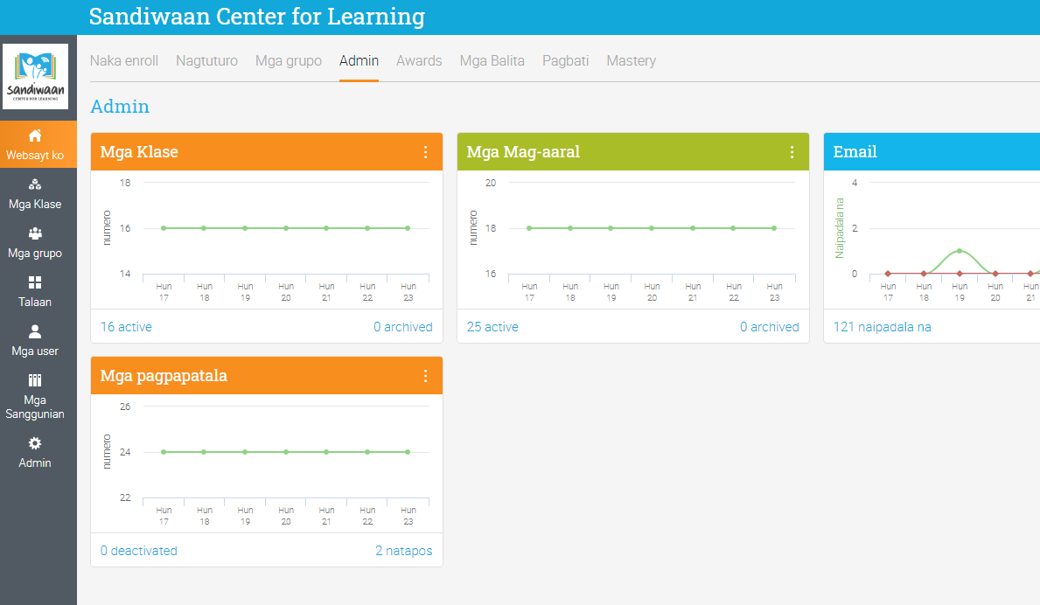
ALS LEARNING
ANYTIME, ANYWHERE
VIRTUAL LEARNING ENVIRONMENT
Tracking the progress of learners and professional development of ALS Teachers
Conduct various types of learning assessments for measurement and evaluation
Allowing learners and teachers to create digital portfolios and manage credentials (badges / certificates)
Track different types of users: students, teachers, mentors, administrators, etc.
Create various groups based on type of users, interest, purpose, etc.
Develop a learning repository composed of content developed specific to ALS and OER from various sources
SANDIWAAN CENTER FOR LEARNING | 2020

Slide 13
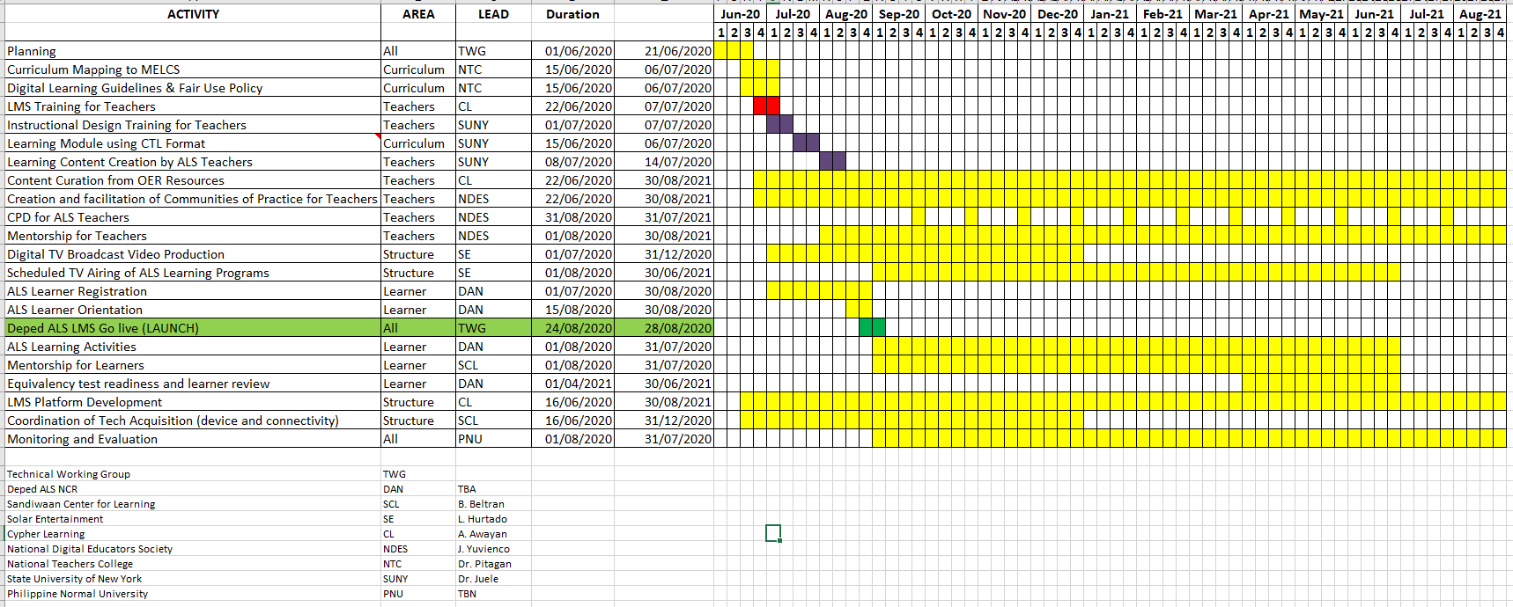
ACTIVITY TIMELINE
SANDIWAAN CENTER FOR LEARNING | 2020

Slide 14
FUNDING SOURCES
ACTIVITY
POTENTIAL FUNDING SOURCE
Subscription-based LMS
Sandiwaan Center fund-raising activities
Professional Development for ALS Teachers
LMS Training Provided by Cypher Learning
CTL & Instructional Design fund-raising by NDES
Internet Connectivity
Sponsorships from telcos
Computers for ALS Learners
Donations of used laptops
Sandiwaan TV Channel
Solar Entertainment
SANDIWAAN CENTER FOR LEARNING | 2020

Slide 15
MONITORING AND EVALUATION
VIA THIRD-PARTY INSTITUTIONS
PROJECT
DEPED
DPA
Project Key Performance Indicators
Compliance to Deped ALS implementation guidelines
Compliance to Data Security and Privacy regulations
SANDIWAAN CENTER FOR LEARNING | 2020

