Slide 1
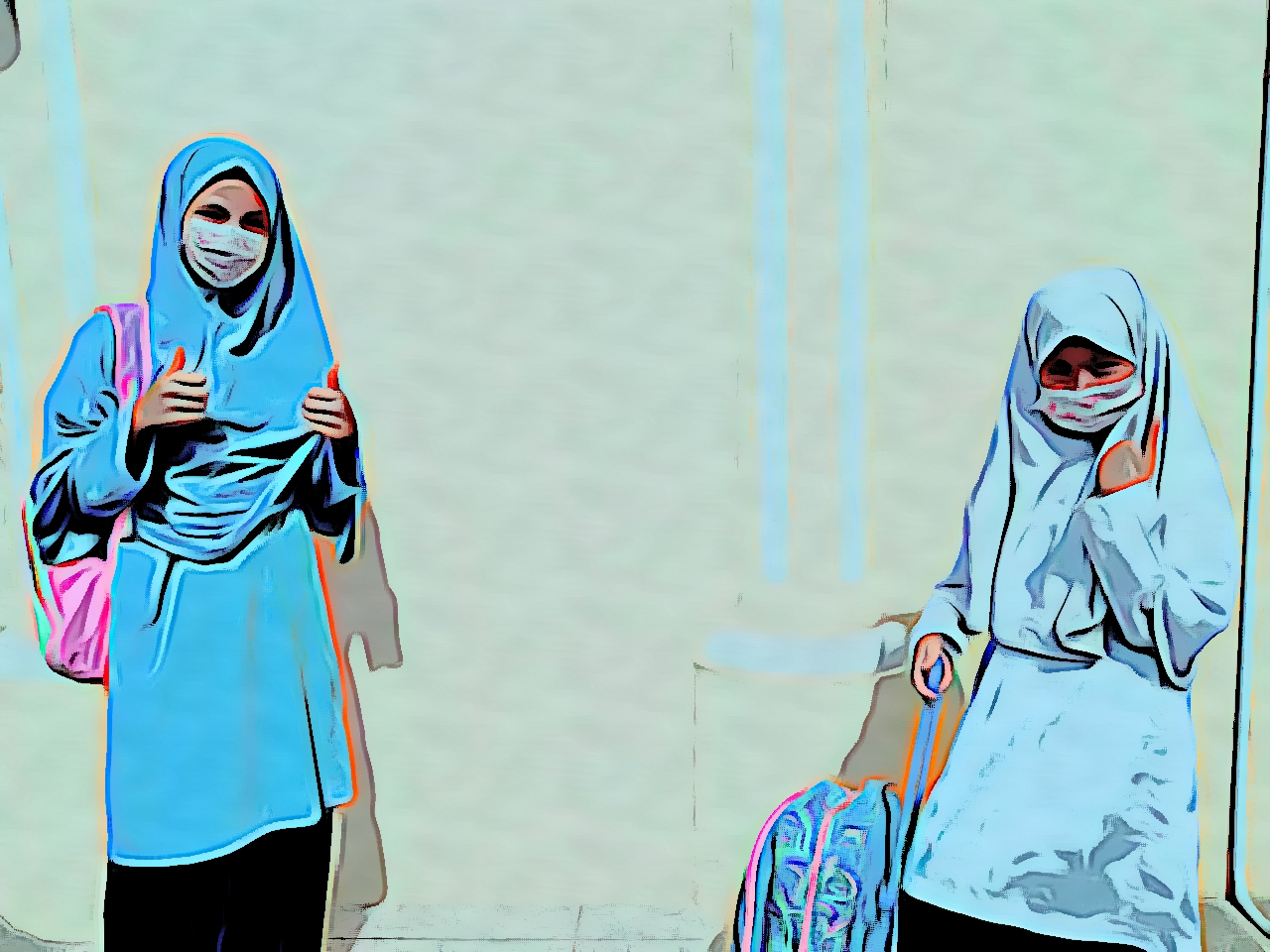
Brunei Darussalam’s Response to Education Disruption and Solutions to Marginalised Groups
Aliuddin Bin Haji Abdul Rahman
Deputy Permanent Secretary (Core Education)
Ministry of Education
Brunei Darussalam

Slide 2
Brunei Darussalam’s response to education disruption and solutions to marginalised groups | Introduction
09 March 2020 – Detection of first COVID-19 case in Brunei Darussalam.
The welfare, safety and well-being of students, teachers and school community is our Top Priority.
12 March 2020 – our immediate action is by bringing forward Term 1 school holiday to ensure the health and safety of our school community.

Slide 3
Brunei Darussalam’s response to education disruption and solutions to marginalised groups | Our Responses
A Blend of Learning: Shifting teaching and learning approaches into online learning, home-based learning and remote learning (including Educational TV programmes, Home-Learning Packs)
Business Continuity Plan (BCP) & Standard Operating Procedure (SOP): Briefing all school leaders and conducting dry runs prior to schools reopening.

Slide 4
Brunei Darussalam’s response to education disruption and solutions to marginalised groups | Our Responses
Modified Curriculum & Assessment : adjusting the curriculum coverage and focusing on formative assessment.
Capacity Building: providing professional development programmes for teachers through on-line trainings and webinar.
Supporting Schools: provision of technical and emotional support.
A Whole of Nation Approach (Collaboration with relevant stakeholders): Working closely with other government agencies (MoH, MTIC, MoRA, MFA, PMO, RTB), non-government agencies (telecommunication providers, UNN) and parents.
Engagement with parents: Communicating and supporting parents.

Slide 5
Brunei Darussalam’s response to education disruption and solutions to marginalised groups
| Tackling inequity in education during and after COVID-19
(marginalized & vulnerable students)
Home Learning Packs: delivery of HLPs to their homes.
Educational TV programmes: for primary school students.
Donation: distribution of devices to underprivileged students .
Connectivity Support: provision of Edu-pack data for students and teachers
Individual Education Plan: customising learning resources and materials for special needs students.
National Feeding Scheme: provision of free meals for at-risk students
Counseling support: focusing on wellbeing and protection of students

Slide 6
Brunei Darussalam’s response to education disruption and solutions to marginalised groups
| Issues and Challenges
Accessibility to online learning : no access to devices and internet.
Adjusting to the new normal in education: adapting to a new way of teaching and learning.
Learning loss / deficit: mitigate risks and focus on remedial education to compensate for lost instructional time.

Slide 7
Brunei Darussalam’s response to education disruption and solutions to marginalised groups
| De-Escalation Stages of Schools Operation during COVID-19
Expected No. of Students Study at School (S@S)
100%
100%
SOCIAL DISTANCING
PERSONAL HYGIENE
SCHOOL CLEANLINESS
48 %
25%
Blended Learning
S@S and HBL
Blended Learning
S@S and HBL
Blended Learning
S@S and HBL
Full Operation
S@S
HBL
0%
Notes:
To ensure the safety and minimise the risk of 2nd wave infection, the government has embarked in the de-escalation approach of schools operation.

Slide 8
Brunei Darussalam’s response to education disruption and solutions to marginalised groups
| Way Forward
Strengthen remote learning: Enhancing school infrastructure (connectivity, introducing Learning Management System (LMS), virtual classrooms, small classrooms)
Build Capacity: professional development and trainings in embracing digital learning and online collaboration including teachers to be provided with use of technology and preparedness; school leaders to implement school practices for using digital devices effectively; school counsellors to support students and parents
Mitigate the impact of the learning losses / deficit: Learning Support Programmes for marginalized / vulnerable students.

Slide 9
Thank You – Stay Safe
Aliuddin Bin Haji Abdul Rahman
Deputy Permanent Secretary (Core Education)
Ministry of Education
Brunei Darussalam

