Slide 1
Response for COVID 19 and Call for Action for Teachers during the Pandemic
Dr Dennis Sinyolo, Senior Coordinator, Education International

Slide 2
Outline
Impact of COVID-19 crisis on teachers, teaching and learning
Education International’s response to COVID-19
International efforts to support teachers, teaching and learning
Main conclusions and recommendations

Slide 3
Impact of COVID -19 crisis on education
According to UNESCO, school closures currently affect over 62,3% (over 1 billion students) in 123 countries
At its peak in April, the pandemic had disrupted the education of nearly 1.6 billion students (over 90% of global student population)
Over 63 million teachers have been affected by the pandemic

Slide 4
Impact of COVID-19 on teachers and teaching
Lack of digital competence: Teachers were required to teach through distance education, yet some of them did not have digital competence, experience nor the tools to do so
Lack of consultation: Some governments came up with decisions on methodologies and tools without consulting with teachers and their unions
Increased workload: In countries where teachers continue to teach virtually/through distance education they report increased workload
Lack of psychosocial support: Teachers need psychosocial support to cope with the situation, and training to be able to support traumatised students, some of whom have lost loved ones (sometimes parents, grand parents or siblings)
Job losses: Contract teachers, supply teachers and teachers in private schools and universities have either not been paid or laid off
Source: EI Covid-19 Survey Report, April 2020

Slide 5
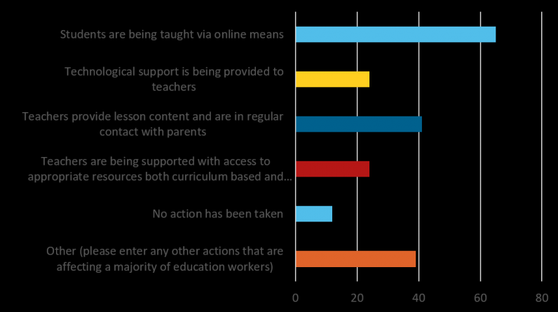
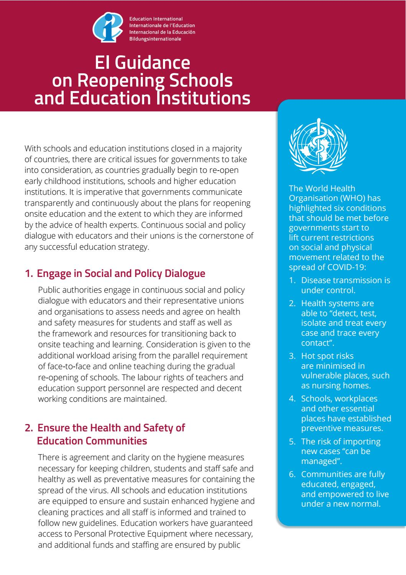
EI’s response

Slide 6
EI’s response to COVID-19
Adopted 12 guiding principles to inform teacher unions and governments’ response to COVID -19
Conducted a survey to assess the impact of COVID-19 on teachers and teaching
Adopted a resolution outlining EI’s key recommendations to governments
Has published a series of blogs written by experts, practitioners and union leaders tackling different aspects of the pandemic in education
Has conducted a series of webinars to enable teachers and school leaders to share experiences and strategies - next joint EI/UNESCO/Teacher Task Force/GEM Report webinar on inclusion, 9 July 2020 (13:00 CET/Paris time)
Launched Guidance to Reopening Schools and Education Institutions
Above tools available here

Slide 7
EI’s 5 pillars for Reopening schools & education institutions
Engage in Social and Policy Dialogue with teachers and their unions
Ensure the Health and Safety of Education Communities
Make Equity a Top Priority – conduct equity audits
Support Physical and Emotional Wellbeing and Recovery
Trust the Professionalism of Educators

Slide 8
Examples of teacher union responses
In India and Nepal, teachers contributed a day’s salary to support governments to fight COVID-19. They also supported migrant workers and poor people with food, soap and face masks
In Indonesia, PGRI (teacher union) has established COVID-19 crisis centres at provincial, district and city level to assist regional governments on COVID-19 prevention and response, including PPE
PGRI has also been running online capacity building courses for its members under ‘Self Driving for Teachers’ (300,000 teachers have benefited)

Slide 9
Examples of teacher union responses (cont.)
In the Philippines, ACT has launched an “ACT4Public Health” programme - monitors effectiveness of government policies, lobbies for the expansion of testing, strengthening of public health system and increased support for education and health workers. ACT has also been distributing food, PPE and masks to the frontline workers
In Malaysia, NUTP conducted a research on schooling based on social distancing which has recommendations for teachers, schools and the government
In Singapore, STU has trained teachers on safety measures and carried out surveys to better understand how teachers are coping with the crisis and teaching during the pandemic

Slide 10
Global Response to COVID-19 in education
UNESCO leadership and coordination:
COVID-19 tracker
Global Education Coalition
sharing of experiences and tools etc.
UNESCO/UNICEF/WB/WFP Framework for reopening schools
Teacher Task Force Tools:
Call to Action on Teachers
Guidance for policy-makers
A toolkit for school leaders

Slide 11
TTF’s framework for reopening schools

Slide 12
Main conclusions & recommendations
There is no replacement for schooling and teachers – technology is not sufficient to ensure equitable quality education for all
Governments must put the health, safety and wellbeing of students, teachers and education support personnel first
Any decision to reopen schools and other education institutions must be informed by guidance from WHO and health experts
Any decision regarding reopening of schools and recovery should be made with the full involvement of educators and their unions

Slide 13
Main conclusions & recommendations (cont.)
Ensure clear policy guidelines to prevent the spread of COVID-19 are in place
Set up a committee or committees to ensure implementation of agreed measures/guidelines
Protect education budgets, teacher salaries and benefits from cuts and invest more to ensure full recovery
Recruit more teachers and education support personnel to cater for the additional classes as a result of social distancing requirements and to ameliorate teacher workload
Ensure teacher training and continuous professional development
Prepare for a possible spike in infections and another round of school closures

Slide 14
Thank you!
dennis.sinyolo@ei-ie.org

